Slide 1
Advanced GUI Techniques
Concepts of Threading

Slide 2
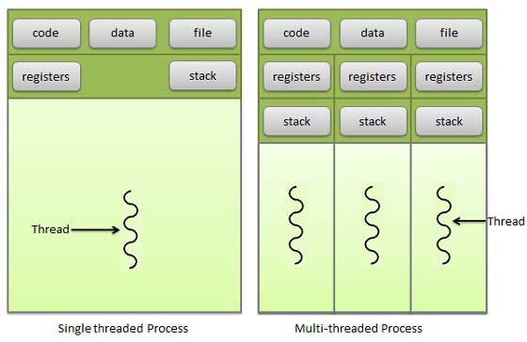
What is a thread-
Your application
Threads live inside a process. Multiprocessors can also handle multiple threads

Slide 3
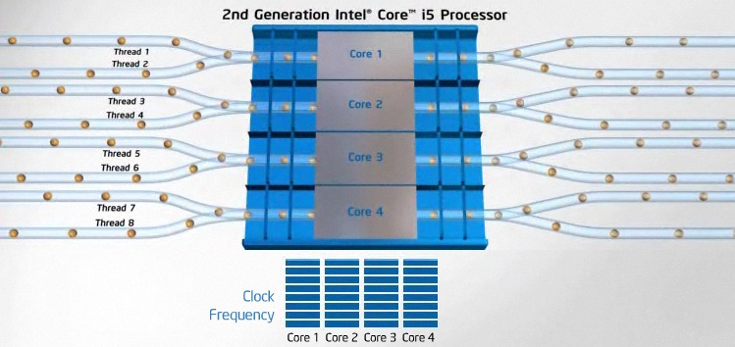
Basic idea - Concurrency
We utilize the hardware more efficiently and get soft/real-time concurrency

Slide 4
Single vs Multi
Notice the different registers and stacks between threads.

Slide 5
Modern Toolkits are threaded
Main GUI Thread
Renderer Thread

Slide 6

Modern Toolkits are threaded
Main GUI Thread
Renderer Thread
Manage Events (I/O)

Slide 7
Modern Toolkits are threaded
Main GUI Thread
Renderer Thread
Manage Events (I/O)
Drawing and Graphical
SYNCHRONIZATION

Slide 8
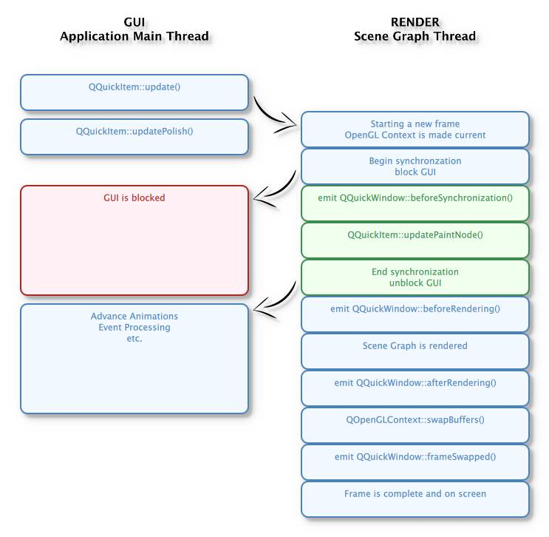
Qt/QML Relationship
Notice the blocking
It is like a dance

Slide 9
Adding a worker thread to the mix
Worker Thread
Main
GUI
Render
Thread

Slide 10
Small workloads might not warrant the overhead
Notice the Overhead
Worker Thread
Main
GUI
Render
Thread

Slide 11
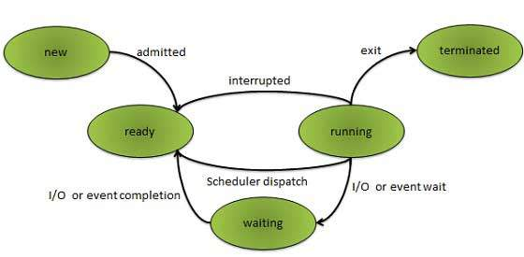
For each thread added,
the system gains overhead
Thread created
Data copied
Thread switch
Remember your application is one of Many

Slide 12
What does this mean for gui?
Proper Use of Thread
Improper Use of Thread
void MyThread:run()
{
initializeVariables();
// begin long running process
// or event system
...
return 0;
}
void MyThread:run()
{
cout << “Hello World”;
return 0;
}
The opposite of a handler, threads should process BIG tasks.
http://doc.qt.io/qt-5/thread-basics.html

Slide 13
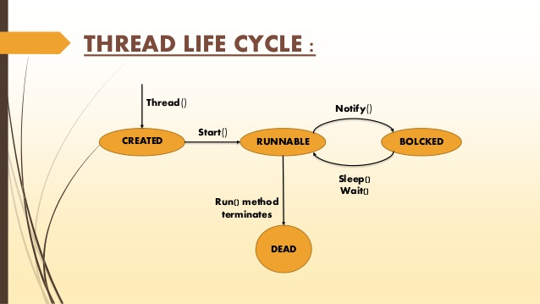
Important concept - Lifecycle
Threads have a lifecycle, with corresponding states.

Slide 14
Important concept - Lifetime
Create
File Parse Thread
Run
Finished
Application Started
Time
One-time-run or threads with short lifetimes - are created, perform their blocking operations, and then are terminated. (Thread pool, and “runnable” thread objects)
(Short)
http://doc.qt.io/qt-5/qthreadpool.html

Slide 15
Important concept - Lifetime
Create
Renderer
Thread
Run
Finished
Application Started
Time
Some thread lifetimes are coupled to the main thread. In multi-threaded GUI toolkits, threads are generated implicitly to handle rendering and other tasks without effort of the developer.
(Long)
http://doc.qt.io/qt-5/qthread.html

Slide 16
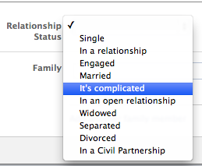
So More Threads the better?

Slide 17
So More Threads the better?
Threads are a resource - Always respect system resources!

Slide 18
What is the right number of threads?
Threads are a resource - Always respect system resources!
Developers must make the effort to choose an appropriate thread count for their target hardware. The toolkit APIs can help with this.

Slide 19
Object Thread Affinity
QObject A
QObject B
Objects live in the stack they were created in

Slide 20


Readings This Weekend (week 7)
Common Qt Classes (Ch 15)
http://qmlbook.github.io/en/ch15/index.html#common-qt-classes
WorkerScript
http://doc.qt.io/qt-5/qtquick-threading-example.html
QThreads
http://doc.qt.io/qt-5/qthread.html
Qt/Qml Signals
http://doc.qt.io/qt-5/qtqml-syntax-signals.html
QRunnable
http://doc.qt.io/qt-5/qrunnable.html

Slide 21
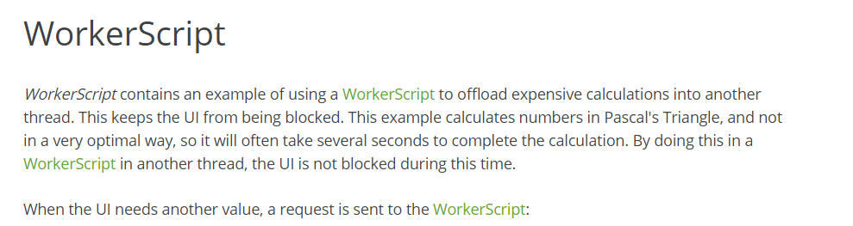
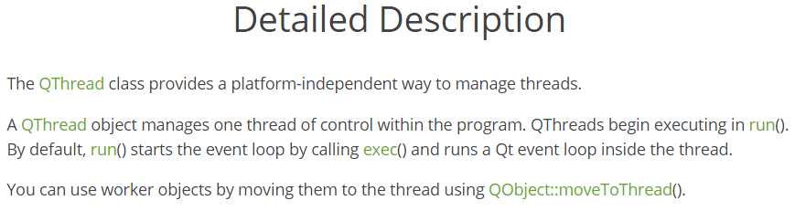
Live Code Demo - WorkerScript Sort
Lecture 1
Lecture 2

